Slide 1
Blitz macroinverts
One GLM, or three?

Slide 2
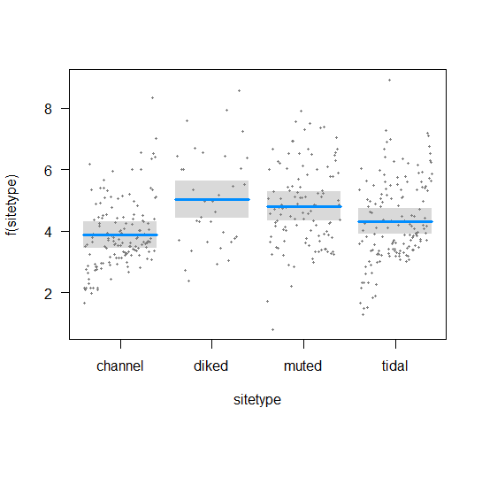
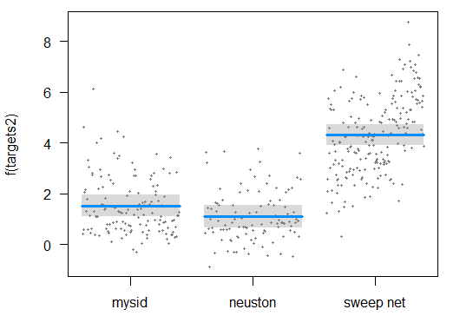
Macroinvert blitz GLMM-everything
Log(CPUE+1) ~ Gear + sitetype + Error(Site)
b
b
Post-hoc shows wetland sites have higher catch overall from channel sites, but wetlands are not different from each other.
Earlier analyses with AIC did not support use of Year or Region as predictor variables
ab
a
 | Estimate | Std. Error | df | t value | Pr(>|t|)
(Intercept: Channel, mysids) | 1.1574 | 0.223 | 15.7878 | 5.19 | <0.0001 | ***
Sitetype: diked | 1.0441 | 0.3741 | 21.252 | 2.791 | 0.01087 | *
Sitetype: muted | 1.0029 | 0.3307 | 10.8019 | 3.032 | 0.01162 | *
Sitetype: tidal | 0.4462 | 0.2935 | 11.6847 | 1.52 | 0.15498
Gear: neuston | -0.5131 | 0.1804 | 429.1981 | -2.844 | 0.00467 | **
Gear: sweep net | 2.7004 | 0.1613 | 435.1671 | 16.741 | < 0.0001 | ***
c
a
b

Slide 3
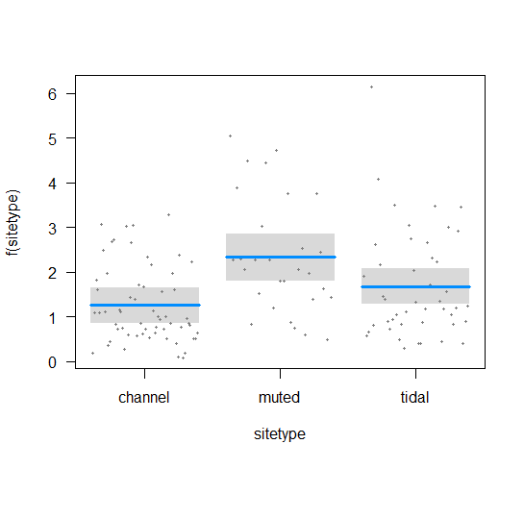
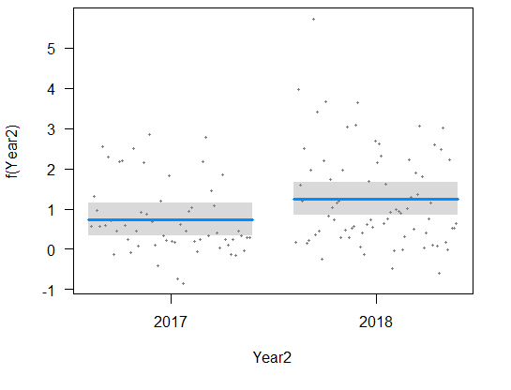
Macroinvert blitz GLMM – Mysid only
Log(CPUE+1) ~ Year + sitetype + Error(Site)
Post-hoc shows wetland sites have higher catch overall from channel sites, but wetlands are not different from each other.
Earlier analyses with AIC did not support use of Region as a predictor variable
b
b
a
 | Estimate | Std. Error | df | t value | Pr(>|t|)
(Intercept) | 0.737 | 0.207 | 12.3707 | 3.561 | 0.00374 | **
sitetypemuted | 1.0789 | 0.3066 | 9.3653 | 3.519 | 0.00613 | **
sitetypetidal | 0.4272 | 0.272 | 9.6402 | 1.57 | 0.14855
Year22018 | 0.5171 | 0.2042 | 122.1982 | 2.532 | 0.0126 | *
b
a

Slide 4
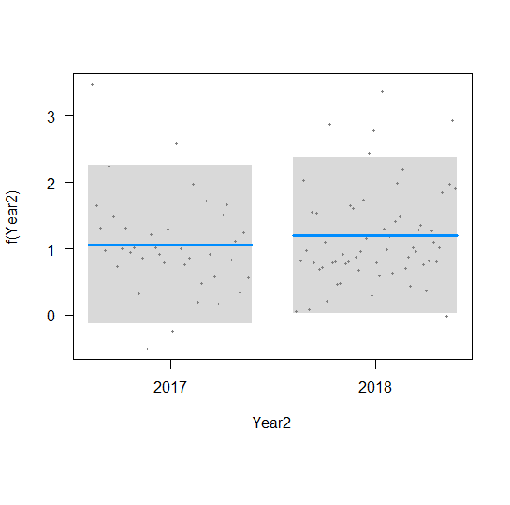
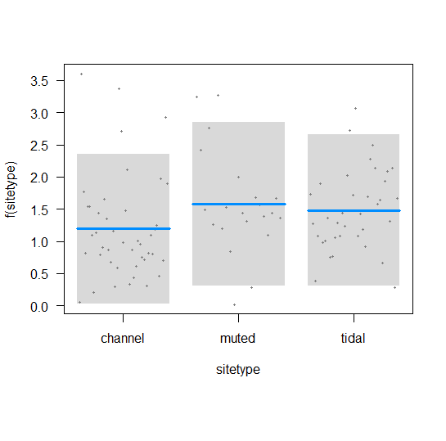
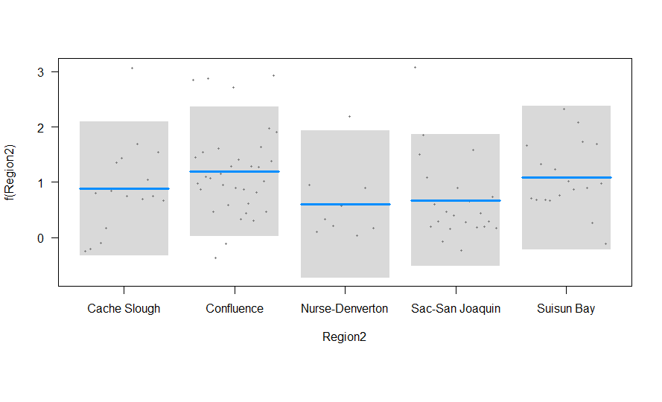
Macroinvert blitz GLMM – Neuston
Log(CPUE+1) ~ Intercept + Error(Site)
AIC selection chooses the intercept-only model.
Global model has nothing significant.

Slide 5
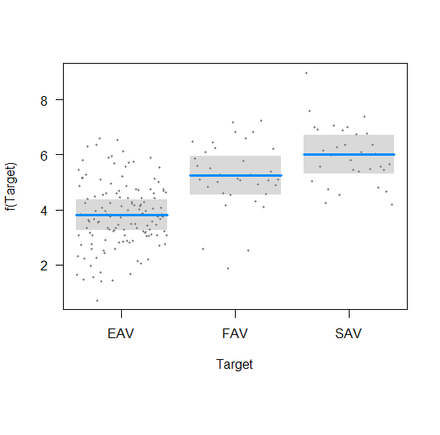
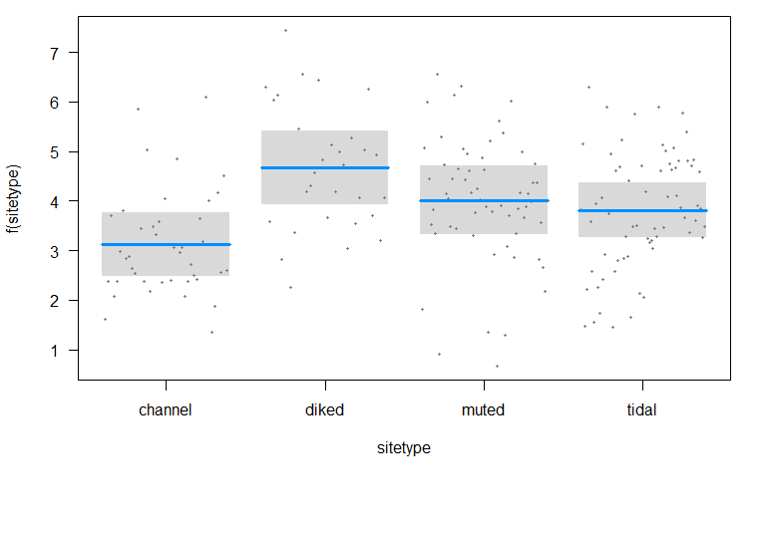
Macroinvert blitz GLMM – sweepnets
Log(CPUE+1) ~ Vegtype + sitetype + Error(Site)
b
c
AIC selection said Region and Year were not included
a
 | Estimate | Std. Error | df | t value | Pr(>|t|)
(Intercept – EAV, channel) | 3.1228 | 0.327 | 11.8857 | 9.551 | 6.34E-07 | ***
Vegtype - FAV | 1.4232 | 0.2571 | 192.226 | 5.536 | 1.01E-07 | ***
Veg type - SAV | 2.1971 | 0.2517 | 191.9606 | 8.729 | 1.24E-15 | ***
Sitetype - diked | 1.5483 | 0.495 | 11.3859 | 3.128 | 0.00925 | **
Sitetype - muted | 0.8904 | 0.4709 | 9.4316 | 1.891 | 0.08969 | .
Sitetype - tidal | 0.6934 | 0.4279 | 10.5153 | 1.621 | 0.13469
b
a
a
a

